Slide 1
Master Thesis Kick-Off: Interactive Analysis of a Corpus of General Terms and Conditions for Variability Modeling
David Koller 23.11.2018

Slide 2
Key Facts
Title: Interactive Analysis of a Corpus of General Terms and Conditions for Variability Modeling
Author: B.Sc. David Koller
Advisor: M.Sc. Ingo Glaser
Supervisor: Prof. Dr. Florian Matthes
Start: October 15th, 2018
End: April 15th , 2019

Slide 3
Outline
Introduction
Motivation
Problem Statement
Research Questions
Interactive Machine Learning Introduction
Data Collection and Preprocessing
Text Classification
Approach
Workflow
Timetable

Slide 4
Motivation
Problem:
No standardized Terms & Conditions
Question of legality of certain clauses
Solution:
Classifying clauses from Terms & Conditions
Identifying universally needes clauses and dependencies
Recognizing unlawful clauses
Goal: Creating a Variability Model of Terms & Conditions containing dependencies, necessary and unlawful clauses

Slide 5
Problem Statement
T&C
Online-Shop 1
Cluster 1
T&C
Online-Shop 2
Cluster 2
Variability Model
Cluster 3
T&C
Online-Shop 3
….
T&C
Online-Shop N
Interactive Machine Learning
Classified Clauses
Interactive Process
Variability Model
Dataset

Slide 6
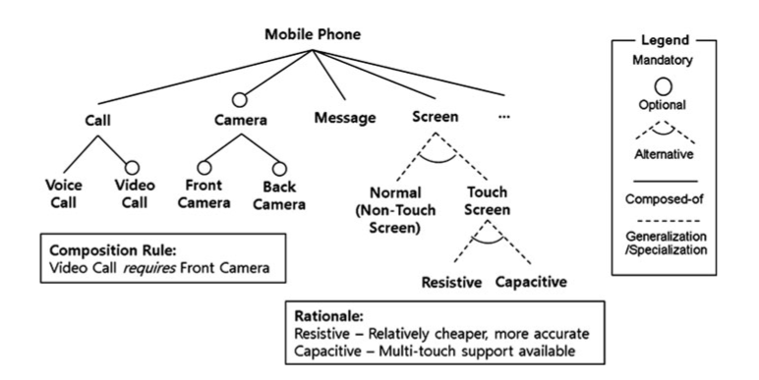
Problem Statement
T&C
Online-Shop 1
Cluster 1
T&C
Online-Shop 2
Cluster 2
Variability Model
Cluster 3
T&C
Online-Shop 3
….
Kang K.C., Lee H. (2013)
T&C
Online-Shop N
Interactive Machine Learning
Classified Clauses
Interactive Process
Variability Model
Dataset

Slide 7
Outline
Introduction
Motivation
Problem Statement
Research Questions
Interactive Machine Learning Introduction
Data Collection and Preprocessing
Text Classification
Approach
Workflow
Timetable

Slide 8
Research Questions
How can interactive Machine Learning support clustering clauses from general Terms & Conditions?
What are suitable classes and how can we classify clauses by their semantic context?
How does a prototypical implementation enabling the semantic text matching of clauses in Terms & Conditions look like?
How should the User Interface for the interaction between software and human expert look like?
What is Variability Modeling and how can it help in observing relations between / lawfulness of clauses?

Slide 9
Analyzing current interactive Machine Learning (iML) solutions to identify possible approach
What is interactive Machine Learning?
“Machine learning with a human in the learning loop, observing the result of learning and providing input meant to improve the learning outcome.”(1)
„Es handelt sich dabei um Algorithmen, die mit – teils menschlichen – Agenten interagieren und durch diese Interaktion ihr Lernverhalten optimieren können.“ (2)
Why interactive ML?
Interactive Machine Learning shows increase in both speed of learning and higher accuracy compared to other approaches.
Solution with purely unsupervised approaches seems unfeasable

Slide 10
Analyzing current interactive Machine Learning (iML) solutions to identify possible approach
Example:
Starting with unsupervised learning
Human expert gives feedback on quality of predictions
Model incorporates feedback for new predictions
Improved Predictions after incorporating human feedback
Unlabled and
Preproccesed
Data
Predictions
Machine Learning Model
Feedback

Slide 11
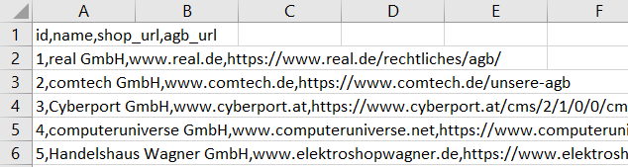
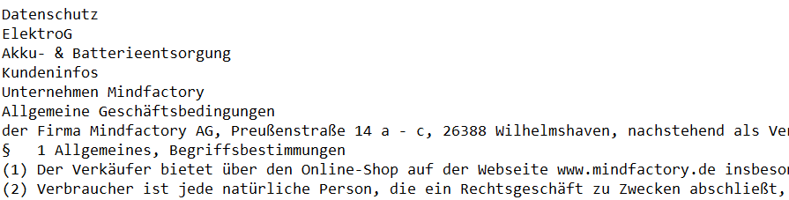
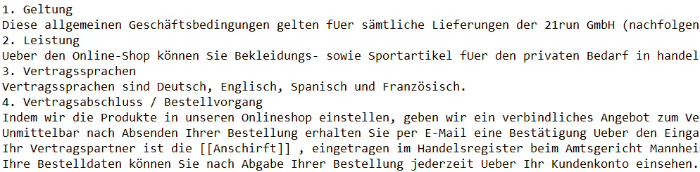
Building a usable Dataset: Data Collection
Creating .csv File containing general information and URLs for Terms and Conditions of partnered Online Shops
Crawling idealo.de for Online Shops
Based on a crawler from Daniel Braun
Extracting the <body> of HTML form collected URLs and creating .txt File for each Online Shop (unfortunately containing irrelevant Information)
Extracting AGBs from Shops
Manually removing irrelevant data, adding placeholders (e.g. for address of Online Shops), and general formatting
Manual Cleanup of collected Text
Important
No labeled Dataset available

Slide 12
Building a usable Dataset: Data Preprocessing
Terms and Conditions
Die Lieferzeit beträgt, sofern nicht beim Angebot anders angegeben, 3-5 Tage.
Tokenization
['Die', 'Lieferzeit', 'beträgt', ',', 'sofern', 'nicht', 'beim', 'Angebot', 'anders', 'angegeben', ',', '3', '-', '5', 'Tage', '.']
Special Character Removal
['Die', 'Lieferzeit', 'beträgt', 'sofern', 'nicht', 'beim', 'Angebot', 'anders', 'angegeben', '3', '5', 'Tage']
Stopwords Removal
['Die', 'Lieferzeit', 'beträgt', 'sofern', 'Angebot', 'anders', 'angegeben', '3', '5', 'Tage']
Lemmatization
[‚der', 'Lieferzeit', 'betragen', 'sofern', 'Angebot', 'anders', 'angeben', '3', '5', ‚tagen']
Word Embedding Algorithm
Word2Vec, Doc2Vec etc.

Slide 13
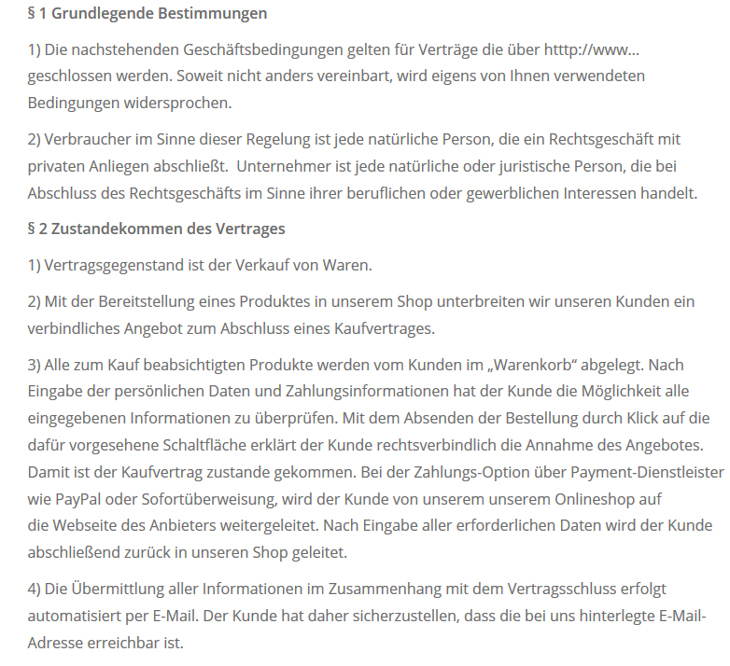
Identification of suitable classes in context of Terms & Conditions
Two possible levels of abstraction for classes:
Paragraph Level:
Each class contains all clauses semantically belonging to one paragraph
Much easier since paragraph title's contain valuable descriptors
Few, but big Clusters (Total number of classes easier to predict: one for each type of Paragraph)
Possible Classes: “§1 Grundlgende Bestimmung”, “§2 Zustandekommen des Vertrages” etc.
Clauses Level:
Each class only contains clauses that are semantically the same
Very hard, since wording in Terms & Conditions differs greatly, which makes finer classification difficult
Many, but more precise Clusters (Total number hard to predict: “how many types of clauses exist?”, Overlap)
Possible classes: “Vertragsgegenstand”, “Vertragsabschluss”
Source: https://website-tutor.com/agb-muster/
Notes:
AGBs mit abweichenden Formulierungen und Sortierungen
„Vertragsgegenstand“ rechts eigenständiger Punkt

Slide 14
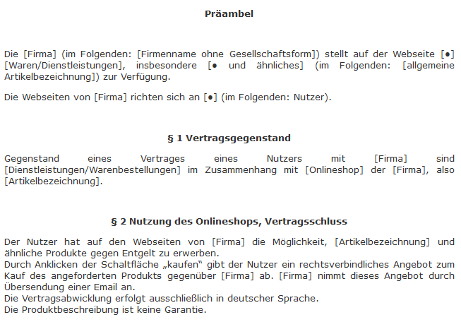
Identification of suitable classes in context of Terms & Conditions
Vertragsgegenstand
Vertragsabschluss
Paragraph
Clause
Sources: https://website-tutor.com/agb-muster/
https://www.juraforum.de/muster-vorlagen/agb-online-shop
Notes:
AGBs mit abweichenden Formulierungen und Sortierungen
„Vertragsgegenstand“ rechts eigenständiger Punkt

Slide 15
Outline
Introduction
Motivation
Problem Statement
Research Questions
Interactive Machine Learning Introduction
Data Collection and Preprocessing
Text Classification
Approach
Workflow
Timetable

Slide 16
Workflow
Literature Research
Literature Research
Interactive Machine Learning
NLP and Semantic Text Matching
Variability Modeling
Evaluation
Accuracy, Recall? Evaluation of clustering difficult without labels
Problem: Human feedback to predictions is subjective. The quality of the results will depend on the quality of the expert interacting with the system.
Evaluation
Design & Implementation
Design & Implementation
Data collection and preparation
Word Embeddings and Clustering Implementation in Python
User interface for interactive Machine Learning

Slide 17
Timetable
October
November
December
January
February
March
April
Literature Research
Data Collection and Preparation
Design & Implementation
Evaluation
Variability Modeling
Writing
Review
Start Date
Kickoff
Submission

Slide 18
B. Sc.
David Koller
17132
matthes@in.tum.de

Slide 19
References
Kang K.C., Lee H. (2013) Variability Modeling. In: Capilla R., Bosch J., Kang KC. (eds) Systems and Software Variability Management. Springer, Berlin, Heidelberg
http://iml.media.mit.edu/
Gesellschaft für Informatik: https://gi.de/informatiklexikon/interactive-machine-learning-iml/
https://website-tutor.com/agb-muster/
https://www.juraforum.de/muster-vorlagen/agb-online-shop

